Slide 1
What is Machine Learning?
Crystal Maung

Slide 2
Learning
Animals and babies
Learn by observation
Learn from experience
Learn from repetition
Scientists (Learning Patterns)
Multiple experiments in control environment

Slide 3
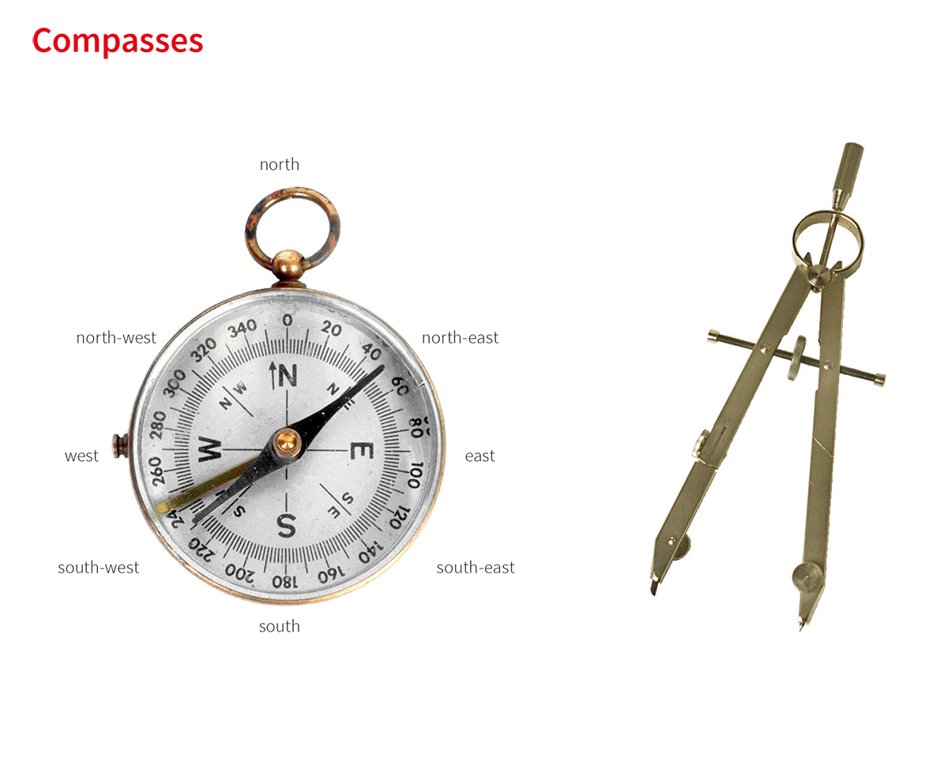

Examples
Calculate circle circumference c from its diameter d or radius r
$$c=3.1415 ∗d=6.283∗r$$
Ideal gas law V = nRT / P (3 known variables)
R = 0.0820573 L atm K⁻¹ mol⁻¹ or 8.3144598 J K⁻¹ mol⁻¹
c
X
d

Slide 4
Comparison
Typical programming
Machine Learning
Use established formula
Fahrenheit to Centigrade
C = (F – 32) * 5/9
If/else statements
Grading algorithm
Use the Intuition of the experts and programmers
Using collected data
Find the pattern or function which can generalize the data
Algorithms for creating those functions → models
Evaluating models

Slide 5
Machine Learning
Finding best models
Simplest model
Generalized model
Accurate model
Time to process
Time to train
Training size needed
Size of model
Memory limitation
Explainability of the model
Domain dependency
ML Algorithms
Models
Training Data
Model
Data
Label / Prediction

Slide 6
ML Life Cycle
Objective or problem to solve
Feasibility study
Data Engineering – More than 80% of the process
Preparation and creation of data
Model Development
Algorithms and models consideration
Training, validation, testing
Model comparison
Deploying and Monitoring
A/B Testing
User experience Survey
Drift Monitoring
Updating the models
Using more relevant data
Using new distribution

Slide 7
Data
Types of Data
Structured
Columnar data stored in DBs, csv files or excel sheets, NoSQL DBs
Logs
Unstructured
Pictures, Videos
Voice data
Text
Sensor data
Logs
Historical Data
Data warehousing
Data Lake
Issues with Data
Domain knowledge
Finding representation of Data to real life situation
Relevancy of Data
Redundancy of Data
Size and distribution of data
Not enough Data
Imbalance class distribution
Missing Data
Missing values in some experiment
Missing relevant feature
Data Type
Correlation to other data
Time relationship to other data
Unusual circumstances

Slide 8
Machine Learning
Supervised Learning
Prediction
Classification – predict discrete label
Regression - predict value
Recommendation
Reinforcement learning
Mostly used in robots
Unsupervised Learning
Clustering
Dimensionality Reduction
Feature extraction
Feature selection
Reinforcement Learning
Carrot and Stick learning
Deep Learning?
Few shot Learning?
Meta Learning?
Generative Models?

Slide 9
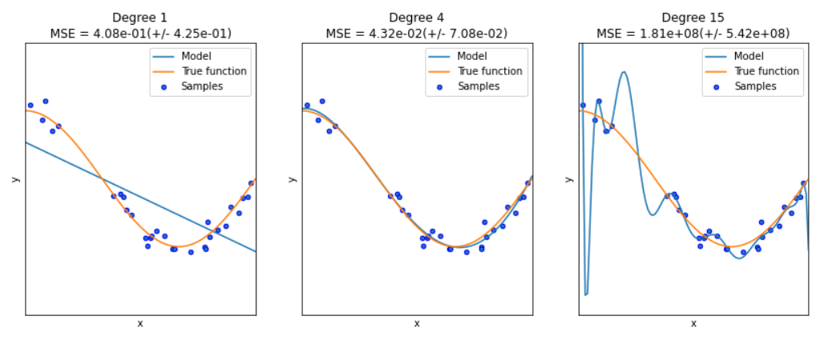
Regression
Function of known variables
Linear function y = a x₁ + b x₂ + c
Non-Linear function y = ax₁³ + b x₁² + cx₁ + dx₂ + e
Learning → Learn the coefficient and best function
Underfit
Overfit

Slide 10
Classification
Predicting a label
Logistic regression predict between 2 class labels
Example: True or False, Spam or not Spam
How to use for multi class problem?
Nearest Neighbor (no training or minimal training needed)
Segmentation of object on an image
How can we use classification?
Multi-label classification
What is the difference?

Slide 11
Recommendation
Netflix prize competition
Shopping basket Analysis
Amazon
Types
Content based filtering (similar movies)
Collaborative filtering (similar users)

Slide 12
Reinforcement Learning
Mostly use in Robotics and Game
Alpha Go
Policy learning
Learning types
Model based
Model free

Slide 13
Clustering
Unsupervised Learning
Clustering algorithms
Centroid-based clustering
Density-based clustering
Distribution-based clustering
Hierarchical clustering

Slide 14
Dimensionality Reduction
Feature extraction
Principle component Analysis
Feature Selection

Slide 15
Finding Best models
Finding generalized parameters or models
Grid Search
K-fold cross validation
Work with small amount of data
Used for parameter search
Time and accuracy trade off
Explaining the model
Feature importance
Evaluating metrics
ROC curve, F1 score, ect.
Comparing model performance
A/B testing

